Slide 1
Making GIS web apps
(at DWR)

Slide 2
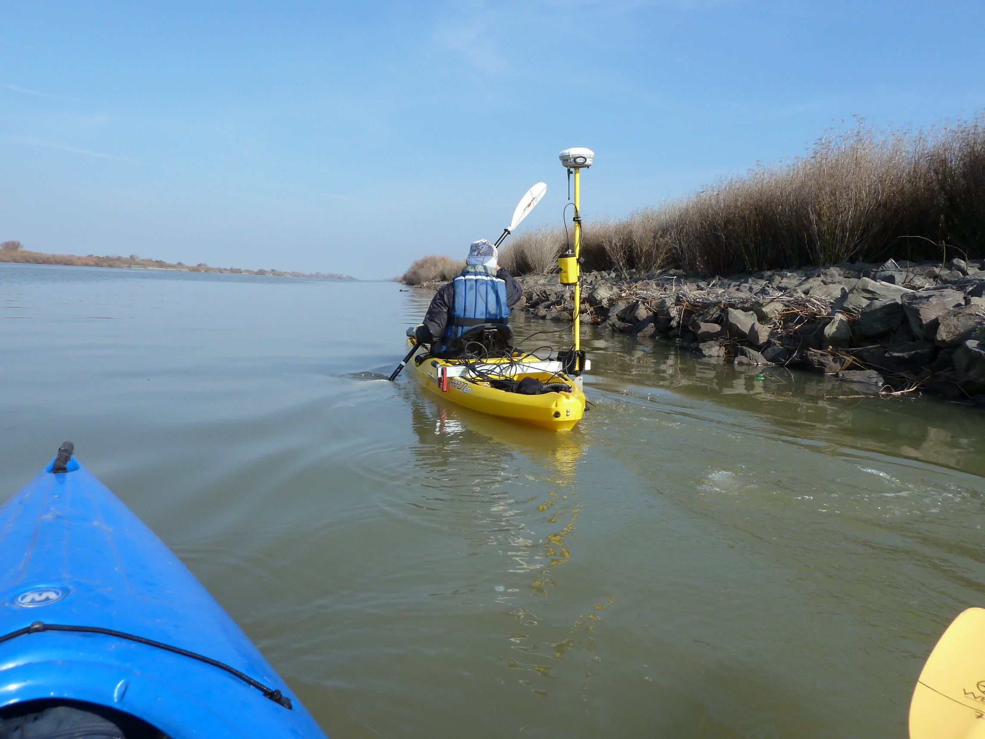
Who is this guy
Wyatt Pearsall
https://github.com/wpears

Slide 3
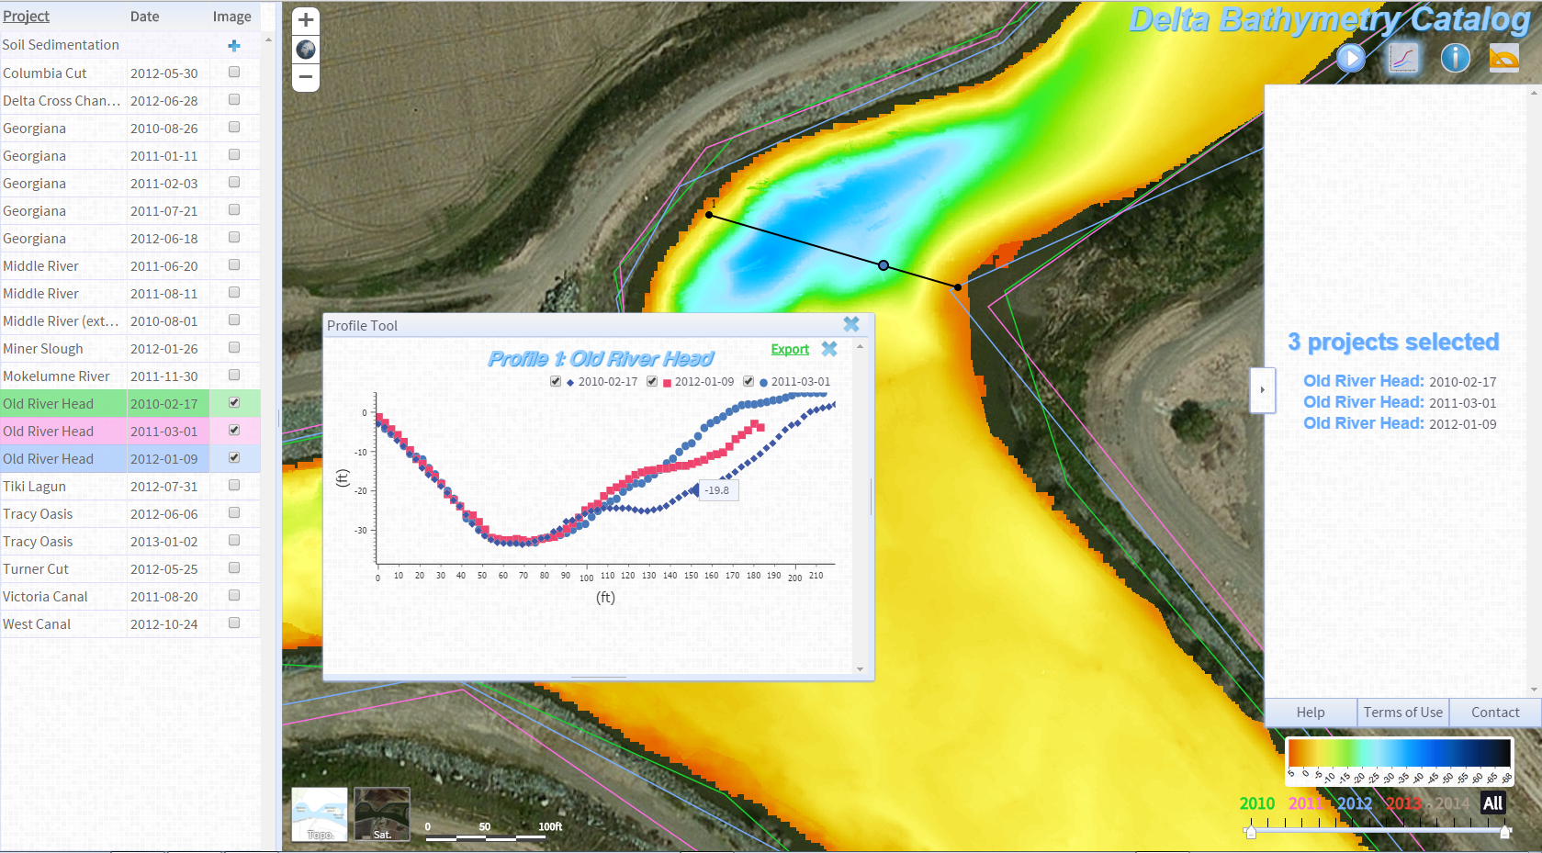

Slide 4
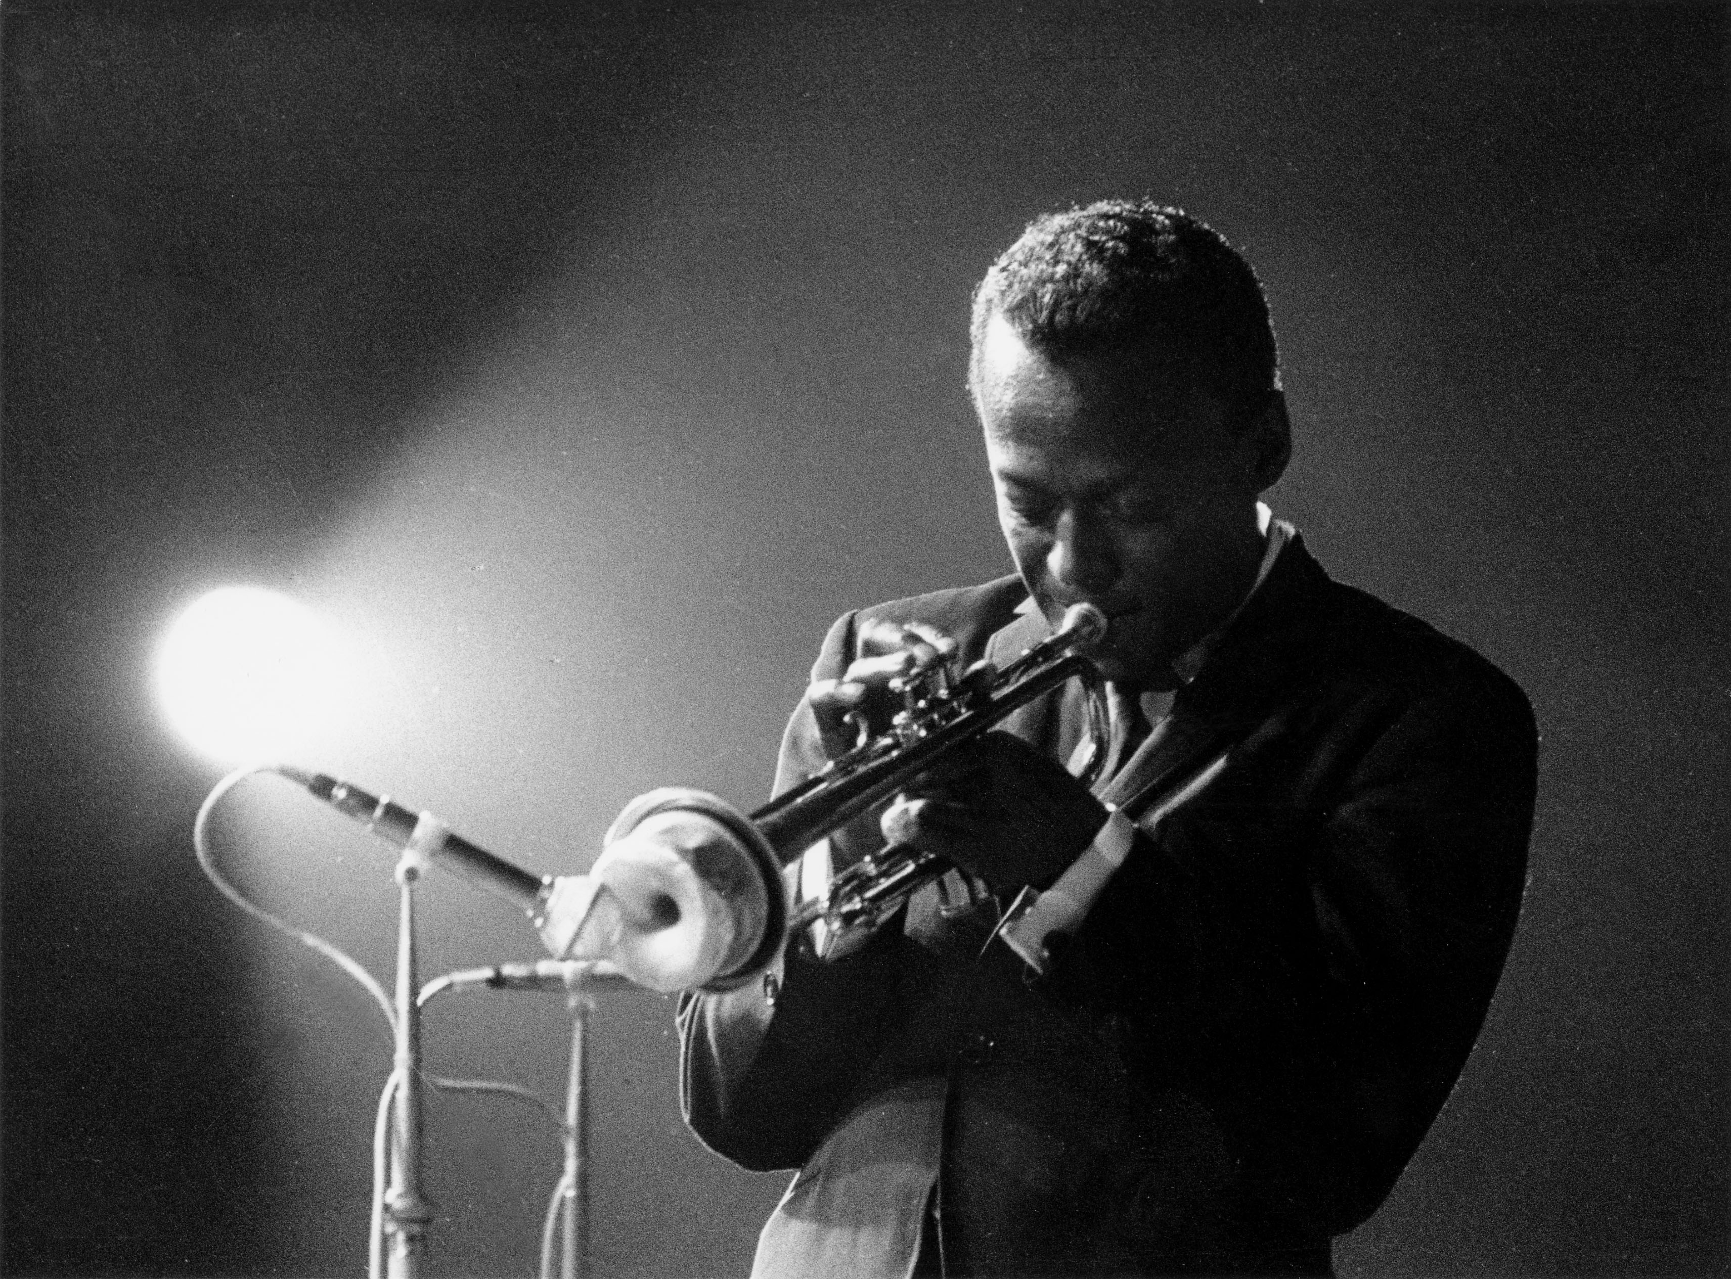

Slide 5
Why web apps
…really, why web apps?

Slide 6


Slide 7


Slide 8
Why web apps
Web apps turn data into information

Slide 9
Why web apps
FTP
Catalog
“Email me”

Slide 10
Why web apps
Interactivity

Slide 11

Why web apps
Interactivity

Slide 12
Why web apps
Interactivity
Visualization

Slide 13
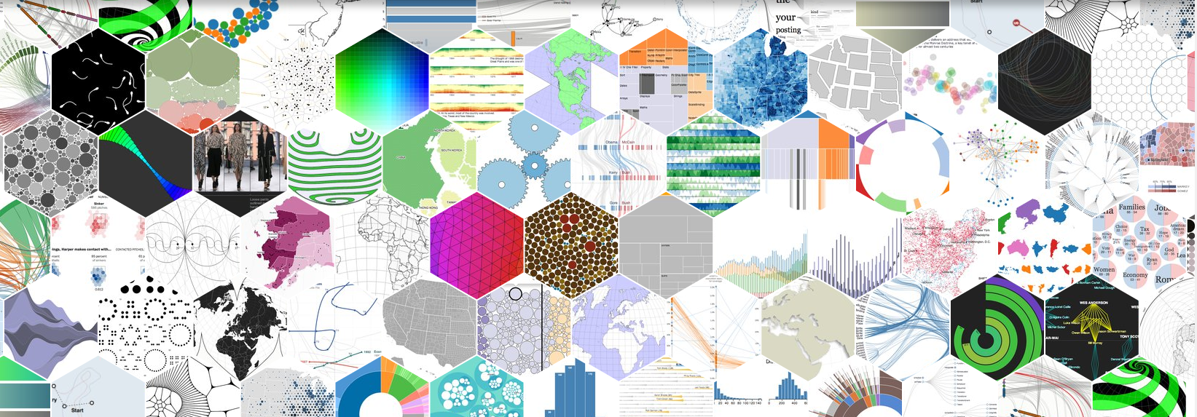
Why web apps

Slide 14
Why web apps
Interactivity
Visualization
Audience

